Slide 1
Brand Presentation
BRAND PRESENTATION · 2026
01

Slide 2
[ DIRECTION ONE ]
This approach expresses [Brand]’s mission through a visual language that is [adjective], [adjective], and [adjective]. It evokes a clear, reassuring [metaphor/imagery] that brings a sense of [feeling] amidst [context/challenge]. The art direction relies on a [color palette], [typography style], [illustration style], and [photography style] — embodying [quality 1], [quality 2], and [quality 3] through a design that [design characteristic] without ever overwhelming.
BRAND PRESENTATION · 2026
02

Slide 3
[ PERSONALITY SLIDERS ]
Niche
Mass Market
Serious
Playful
Conventional
Disruptive
Friendly
Mass Market
Mature
Authoritative
BRAND PRESENTATION · 2026
03

Slide 4
02
Logo
Typography
Colors
Iconography
Photography
Applications
Brand

Slide 5


[ LOGOMARK ]
The [Brand] logo comes in two complementary formats: a compact version for smaller use cases, and a full version to express the brand with [adjective], [adjective], and [adjective] in any context.
BRAND PRESENTATION · 2026
05

Slide 6
03
Logo
Typography
Colors
Iconography
Photography
Applications
Brand

Slide 7
[ TITLE TYPEFACE ]
For all headings, we use [Heading Typeface], the [serif/sans-serif] version of the type family. Choosing this typeface brings an inherently [adjective] and [adjective] touch to the brand, with [design feature 1] and [design feature 2] that add [quality] and [quality].
Its [shape/style] and [contrast/weight] bring rhythm, identity, and presence — perfectly aligned with [Brand]’s tone: [adjective], [adjective], and [adjective]. It helps messages stand out while remaining [adjective] and [adjective].
Archivo
Aa Bb Cc Dd Ee Ff Gg
Hh Ii Jj Kk Ll Mm
Nn Oo Pp Qq Rr Ss Tt
Uu Vv Ww Xx Yy Zz
1234567890&!$
BRAND PRESENTATION · 2026
07

Slide 8
[ BODY TYPEFACE ]
For all body texts and interfaces, we use [Body Typeface], the [serif/sans-serif] version of the same family. This ensures visual consistency across all formats while offering perfect typographic pairing with [headings/titles] — same [design DNA], different roles. Its [design feature 1] and [design feature 2] enhance legibility while maintaining a [adjective] and [adjective] tone.
Geist
Aa Bb Cc Dd Ee Ff Gg
Hh Ii Jj Kk Ll Mm
Nn Oo Pp Qq Rr Ss Tt
Uu Vv Ww Xx Yy Zz
1234567890&!$
BRAND PRESENTATION · 2026
08

Slide 9
[ LABEL TYPEFACE ]
For all label texts and interfaces, we use [Label Typeface], the [serif/sans-serif] version of the same family. This ensures visual consistency across all formats while offering perfect typographic pairing with [headings/titles] — same [design DNA], different roles.
Archivo
Aa Bb Cc Dd Ee Ff Gg
Hh Ii Jj Kk Ll Mm
Nn Oo Pp Qq Rr Ss Tt
Uu Vv Ww Xx Yy Zz
1234567890&!$
BRAND PRESENTATION · 2026
09

Slide 10
04
Logo
Typography
Colors
Iconography
Photography
Applications
Brand

Slide 11
[ PRIMARY PALETTE ]
The primary tones set the ground with warm, quiet colours that add clarity, calm and a grounded, confident character. Paper and ink do most of the work; periwinkle is the only accent, kept for links and focus.
Olive
Paper
Ink
#6A6B52
#FFFFFF
#2B2B2B
#5A61D4
#8F96EE
BRAND PRESENTATION · 2026
11

Slide 12
[ SECONDARY PALETTE ]
The secondary tones expand the visual expression with soft greys and deeper olives that add depth, rhythm and a natural, understated character. They paint larger surfaces, like the hero and footer, and support olive in the team section.
Mist
Fog
Olive Light
Olive Deep
#D3D1D4
#AEBAC4
#7B7C60
#4E5540
BRAND PRESENTATION · 2026
12

Slide 13
05
Logo
Typography
Colors
Iconography
Photography
Applications
Brand

Slide 14
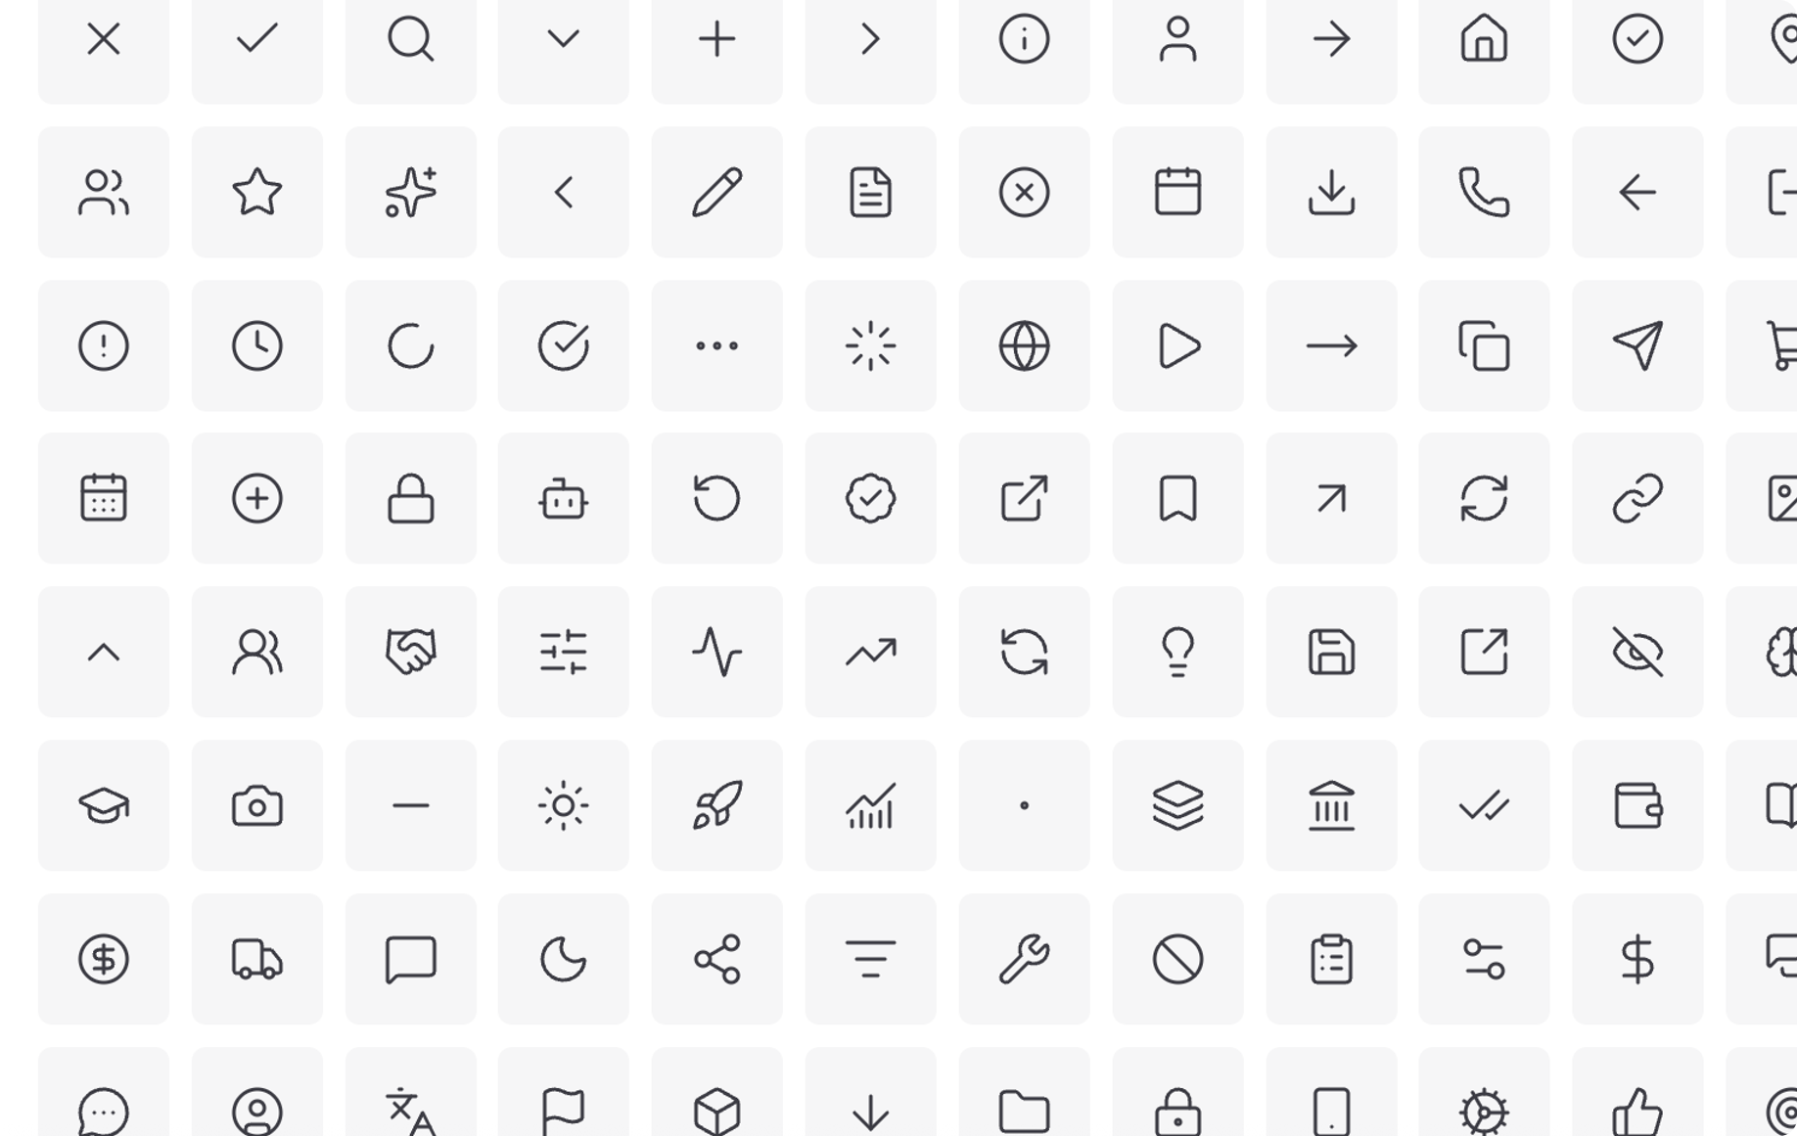
[ APP ICONS ]
These icons illustrate key [category type] categories, from [example 1] to [example 2]. Their [style] style brings [quality 1] and [quality 2] to the [platform/product], reinforcing a [adjective], [adjective] user experience.
BRAND PRESENTATION · 2026
14

Slide 15
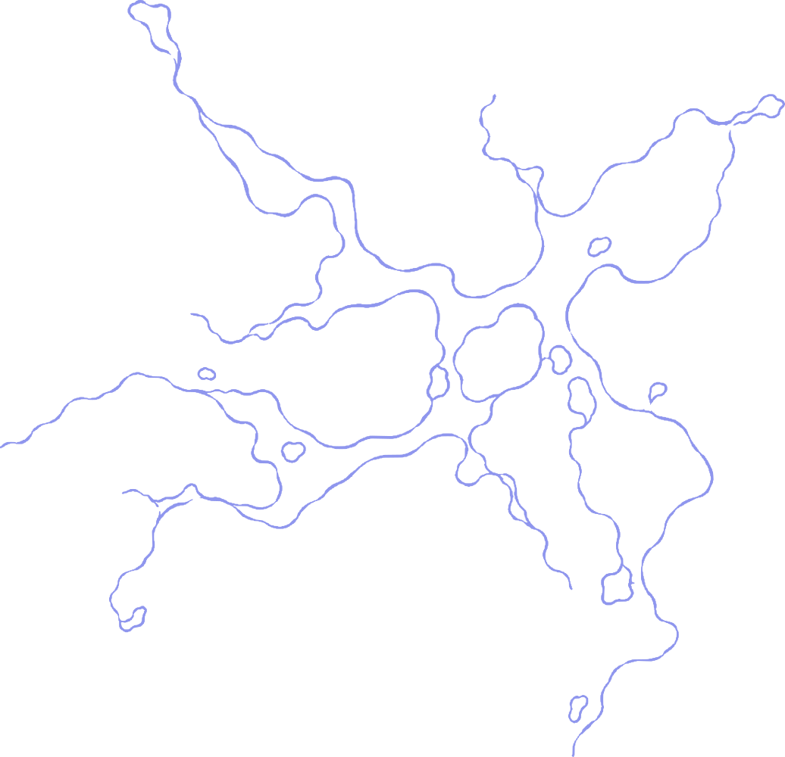

[ ILLUSTRATIONS ]
[Character/mascot] adapts to every mood and context, from [situation 1] to [situation 2]. [It/They] bring the brand to life and make it more [adjective], [adjective], and emotionally engaging.
BRAND PRESENTATION · 2026
15

Slide 16
06
Logo
Typography
Colors
Iconography
Photography
Applications
Brand

Slide 17
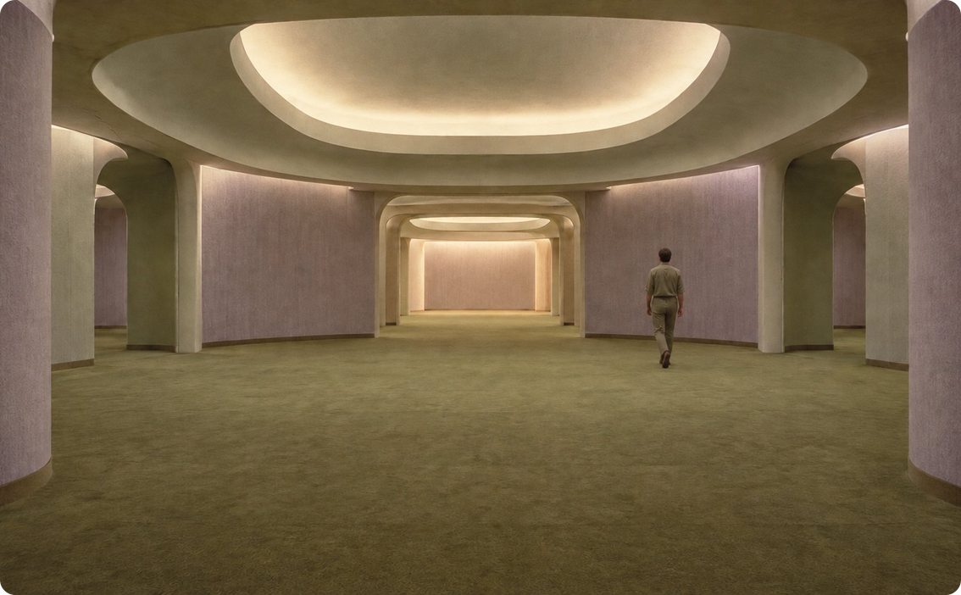
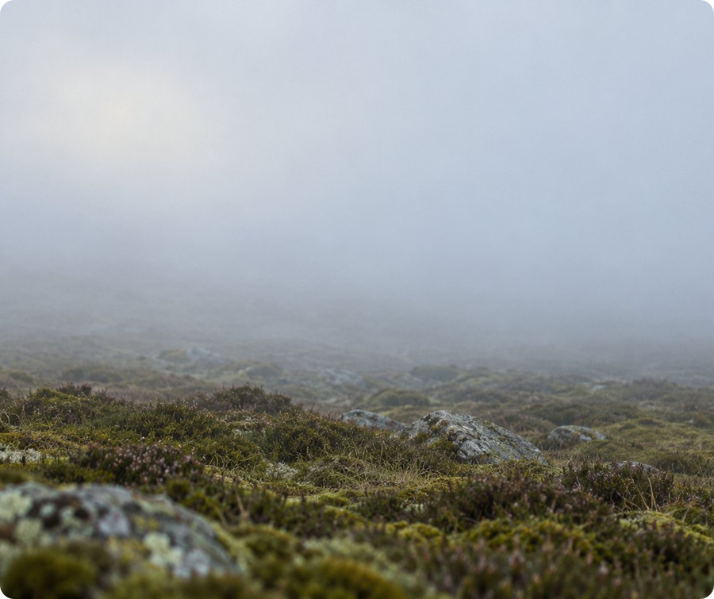
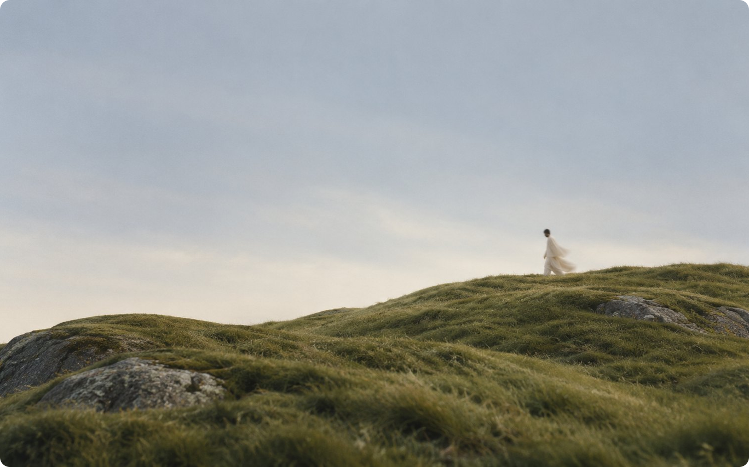
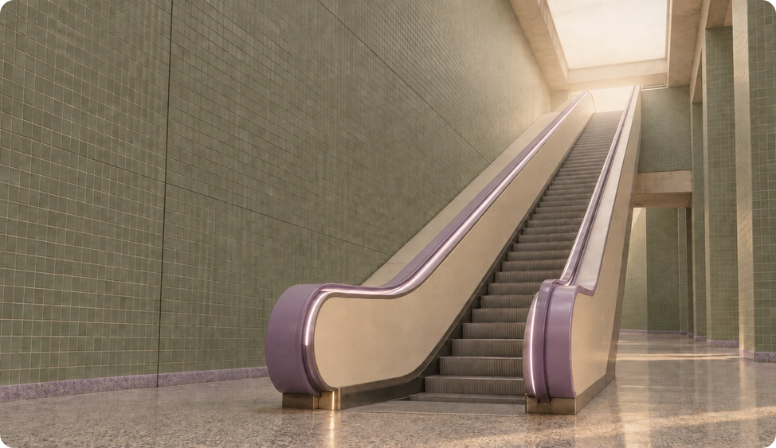
[ PHOTOGRAPHY ]
The photo direction captures the moment before something big: one person on a hill, a ledge, a starting line, under a clear deep-blue sky. Light is warm and directional, like late afternoon. Colors are clean and confident: deep blue, golden grass, soft white. Frames are minimal and slightly surreal, with lots of sky left for words. People are small in the frame, never posed.
BRAND PRESENTATION · 2026
17

Slide 18
07
Logo
Typography
Colors
Iconography
Photography
Applications
Brand

