Slide 1


DESIGN STUDIO
TWO PEOPLE, ONE SPRINT AT A TIME
The prototype you’ll show at your next big moment
Two seniors design and build it, with a brand that looks and sounds like you. Share it with one link.
THE DEMO, THE RAISE,
THE LAUNCH.

Slide 2
[ WHY NOW ]
Everyone can build now. The bar went up.
Building it yourself is fast. Hiring a designer gets you craft. With us you get both, plus the brand behind it, from the same two people.
STUDIO INTRO · 2026
02

Slide 3
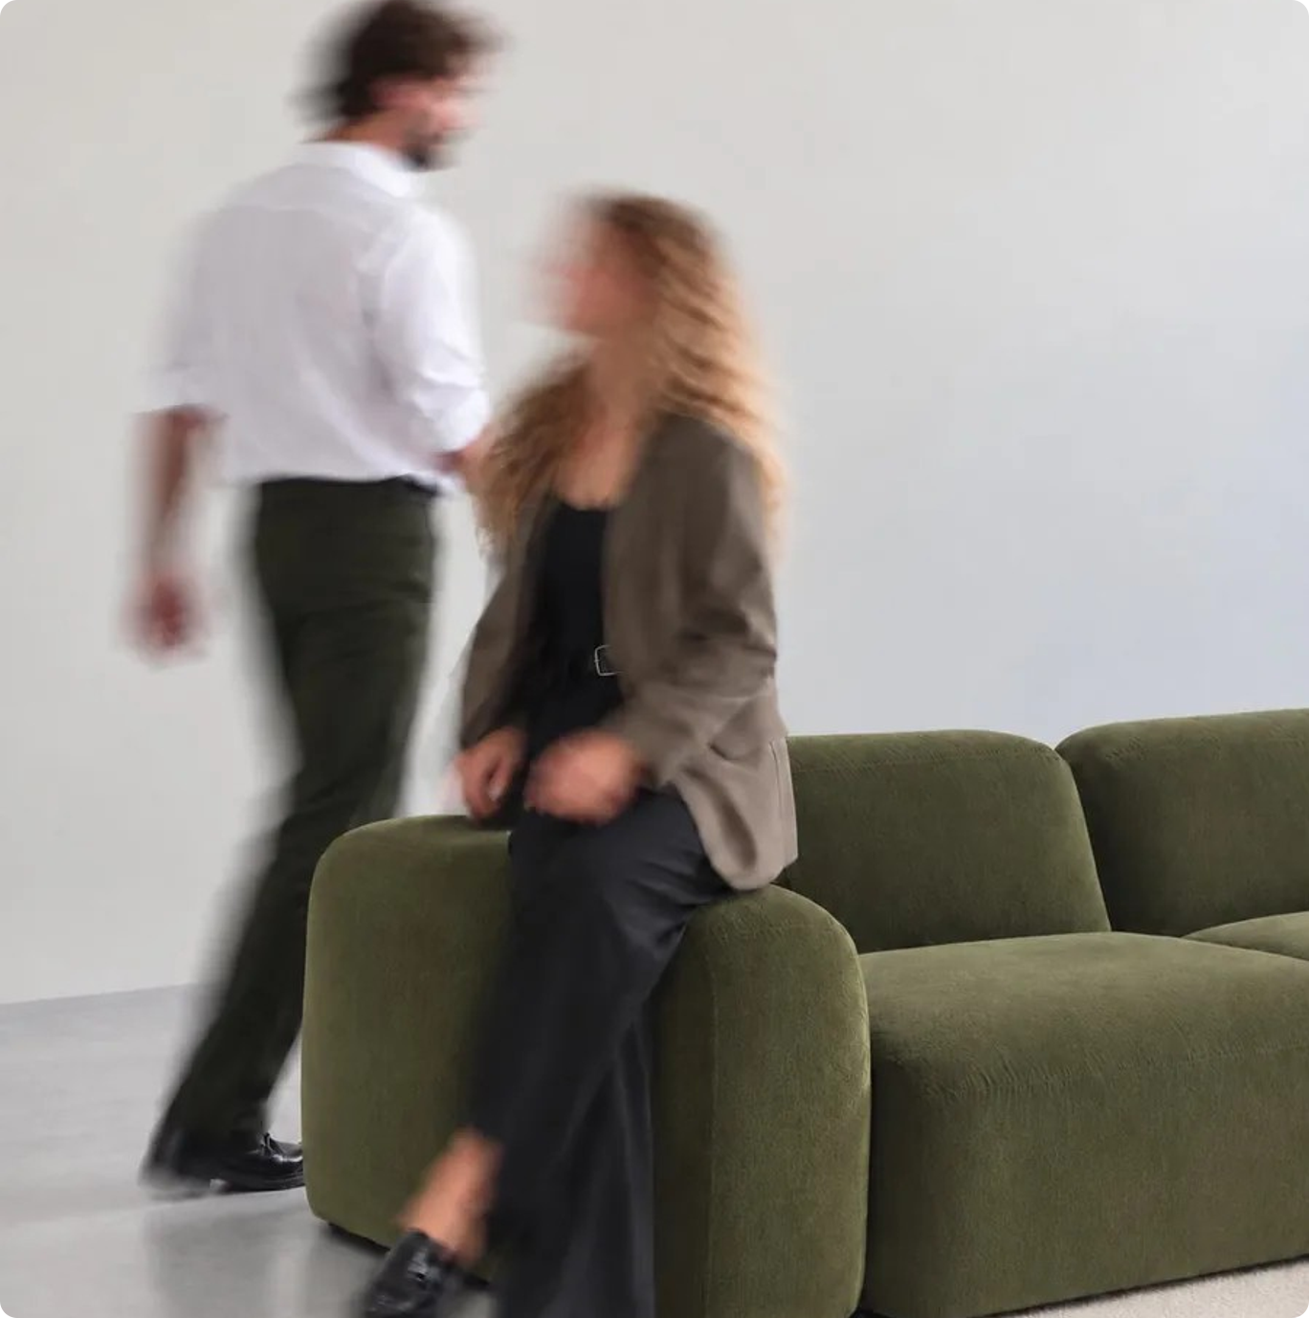
[ THE STUDIO ]
A two-person studio for early teams
We’re Oliver and Ieva. We build the prototype you’ll show, the design it runs on and the brand behind it, all from your story.
STUDIO INTRO · 2026
03

Slide 4
[ WHO IT’S FOR ]
Founders with first money and a big moment ahead
YOU’VE BUILT SOMETHING
YOU HAVE THE IDEA
Send us your build
Or just your story
YOU BRING
A working app, often made in Lovable or v0.
YOU BRING
A story, and maybe a deck.
WE DO
Rebuild the screens that matter most, and give the whole product a look and voice of its own.
WE DO
Build the first version from your story.
STUDIO INTRO · 2026
04

Slide 5

[ THE SPRINT ]
01 / 02
Two weeks, fixed price

Slide 6
[ HOW WE WORK ]
From your story to your moment
01 / 03
STORY
We start with your story
A kickoff session to get clear on who it’s for and what your moment needs. That becomes your brand base.
02 / 03
BUILD
We build it. You watch it take shape
We design and build it together, technical setup included. Every version gets its own link.
03 / 03
MOMENT
You take it into your moment
Share one link with investors or your first users. When your engineers are ready, it’s one pull request away.
STUDIO INTRO · 2026
06

Slide 7
[ THE TWO WEEKS ]
Week one is your story and brand. Week two is the product.
WEEK 1 · MON
WEEK 1 · WED
WEEK 1 · FRI
WEEK 2 · MON–THU
WEEK 2 · MID-WEEK
WEEK 2 · FRI
Kickoff
Two directions
Brand locked
The product, in code
One review
Handover
45 to 60 minutes on your story and what your moment needs.
Each has a wordmark, colours, type and one sample screen. You pick one.
One round of changes on the direction you chose. Then it’s fixed.
The design system and your screens, with the copy.
You comment on the live preview. One round of changes.
Your Base is finished. A 30-minute call on how to use it.
STUDIO INTRO · 2026
07

Slide 8
[ YOUR TIME ]
About two hours of your time across the whole sprint
30 min
60 min
Discovery call. Is this a fit, what we’ll build, and when.
Kickoff, 45 to 60 minutes. Your story, and the reactions a questionnaire can’t capture.
30 min
30 min
Everything else is async: one clear question at a time, with a deadline.
Brand directions, 20 to 30 minutes. The biggest decision in the sprint, so we make it live.
Handover. So you and your developer know how to use the Base.
STUDIO INTRO · 2026
08

Slide 9
[ WHAT YOU GET ]
The Base: one private home for your prototype, design and brand
01
02
03
04
Brand
Design system
Prototypes
AI-ready files
Logo, colours, type, voice and positioning, with downloads in common formats.
Tokens and the 8 to 10 components your prototype uses, each with short notes.
Live links and real code, one pull request away from your engineers.
brand.md, design.md and tokens your own Lovable or Claude can read, so what you build next stays on brand.
STUDIO INTRO · 2026
09

Slide 10
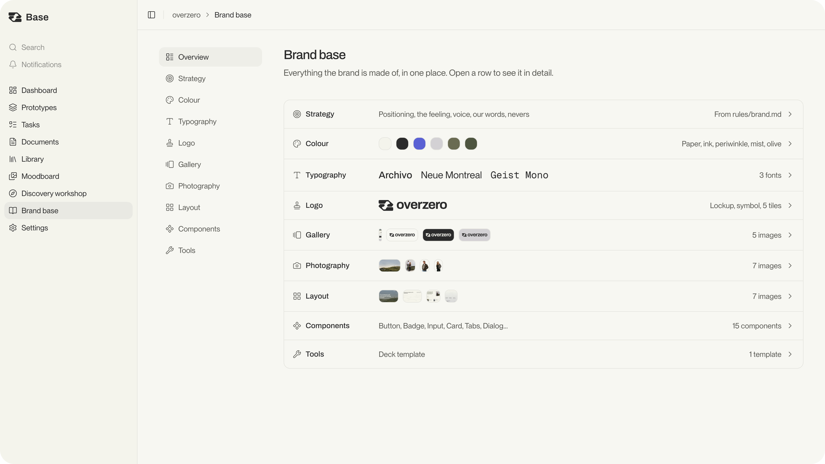
[ THE BASE ]
OVERZERO’S OWN BASE: THE BRAND, THE DESIGN SYSTEM AND THE PROTOTYPES ON ONE LINK
STUDIO INTRO · 2026
10

Slide 11
[ YOURS TO KEEP ]
What you walk away with
Brand page
Logo files, colours and type, ready to download.
Design system
With notes, and a page on how to extend it.
Prototype
Live links and the repo.
AI-ready files
brand.md, design.md and tokens.
In your own repo from day one. Yours whether or not you stay with us.
Quality checklist
For every new screen: spacing, type, tokens, contrast and states.
Handover call
So you and your developer know how to use it.
STUDIO INTRO · 2026
11

Slide 12

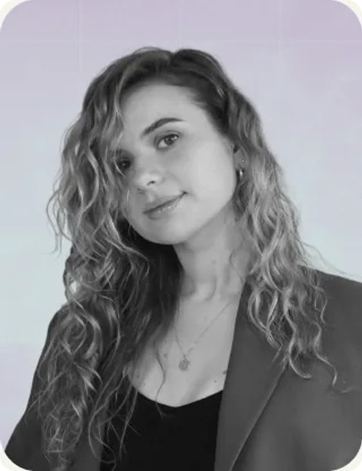
[ MEET THE TEAM ]
Oliver and Ieva. You talk to the people doing the work.
STRATEGY
DESIGN
Oliver
Ieva
Positioning, messaging and the Base your brand lives in. Systems thinker, loves when it clicks. Prev. Hays, communications manager.
Senior designer with agency and big-tech craft. Shipped at scale, obsessed with detail. Prev. Wix, product designer.
POSITIONING AND MESSAGING
TONE OF VOICE
PRODUCT DESIGN
CLICKABLE PROTOTYPES
DESIGN SYSTEM
YOUR BASE: ONE PRIVATE HOME, ONE LINK
STUDIO INTRO · 2026
12

Slide 13

[ PRICING ]
02 / 02
What it costs

Slide 14
[ PRICING ]
A sprint for your next moment. Monthly for everything after.
SPRINT
2 WEEKS · FIXED
MONTHLY
PER MONTH · PAUSE ANY MONTH
€4,000
€5,000
Your prototype, design and brand base, built for one big moment.
After the moment, we keep your brand, design and prototypes moving as you learn from your first customers.
Two brand directions to choose from
New flows and screens
One round of changes on the brand, one on the product
A pitch deck, or launch materials
One product: a web app flow, a mobile flow or a website
One piece of work at a time
Your Base, in your own repo
Base upkeep, always included
STUDIO INTRO · 2026
14

Slide 15
[ WHAT WE DON’T PROMISE ]
Nobody can honestly promise you funding.
What we do promise: something real to click through, that looks, feels and sounds like you. It’s a prototype, not a production app. Your engineers take it from there.
STUDIO INTRO · 2026
15

Slide 16
[ FAQ ]
Questions founders ask before the call
What do we get at the end of a sprint?
Your Base: a clickable prototype on its own link, the design it runs on, and your brand base. Yours to share and keep.
What do you need from us to start?
A 30-minute call and a few lines on your moment. If you’ve built something, a link or repo access.
Do I need to start with a sprint?
Usually yes. The sprint sets up your brand base and the Base it lives in; the monthly plan builds on top.
Can the prototype go straight to production?
No, it’s a prototype. It’s real code, and your engineers take it from there, one pull request away.
Isn’t it too early for branding?
That’s why we set up a starting point that changes as you learn from your first customers, not a full identity.
Do you work in Figma?
Mostly in code, so you react to something real rather than a picture of it. Figma comes in where it helps.
STUDIO INTRO · 2026
16

Slide 17
[ NEXT STEP ]
Let’s work out what to build for your moment.
BOOK A CALL →
30 MINUTES · FREE
HELLO@OVERZERO.STUDIO
BASEL / VILNIUS
STUDIO INTRO · 2026
17

Slide 18
What’s your moment, and when is it?
HELLO@OVERZERO.STUDIO
BASEL / VILNIUS

